Slide 1

Escape Sequences and Basic Shell scripting.
Sijumary johnson

Slide 2
Echo command
Echo command is used to print the data.
Echo $SHELL command is used to get the shell we are currently in.(default: BASH)
Options Tasks
-n Gives output without going to new line
-e Allows use of backslash escapes
\b Removes spaces between the texts
\n Prints text in new line
\t Horizontal tab
\v vertical tab

Slide 3
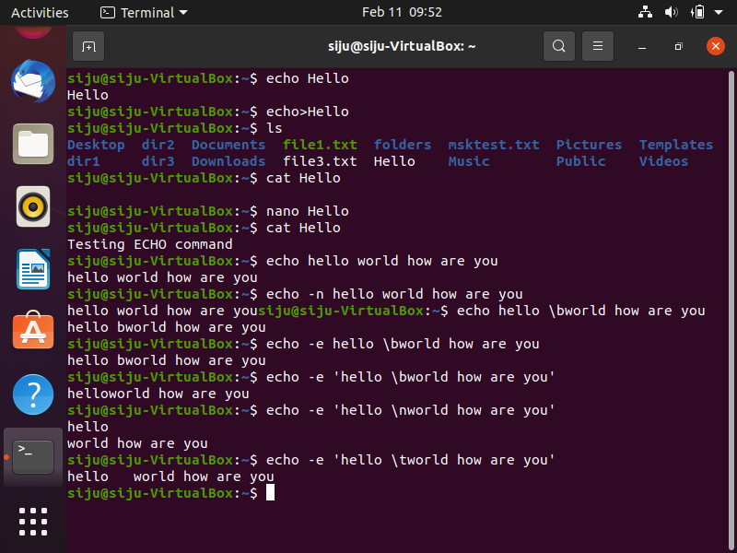
Screenshot

Slide 4
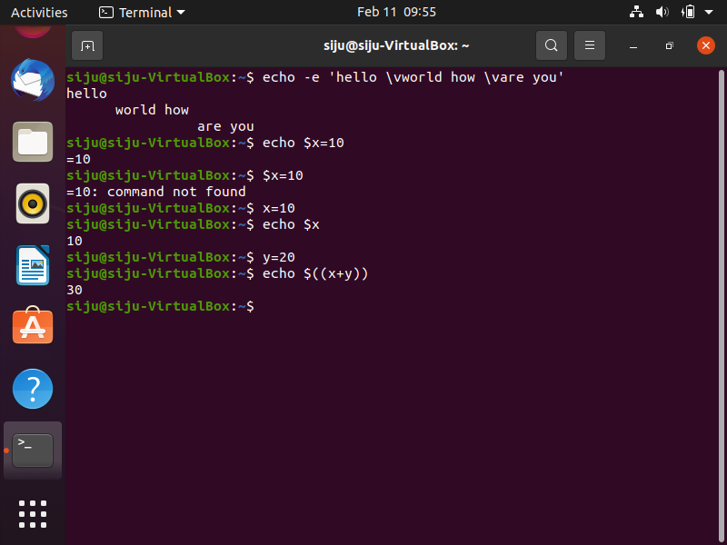
Printing and storing variables

Slide 5
Types of variable commands
There are 3 types of variable commands: Set, Export and Unset variable commands
Export variable command create environment access specific commands.
Unset variable command removes variables that are already set.
-bash command is used to work in the specific bash shell.
To access variable in other shells then use : export <varname>

Slide 6
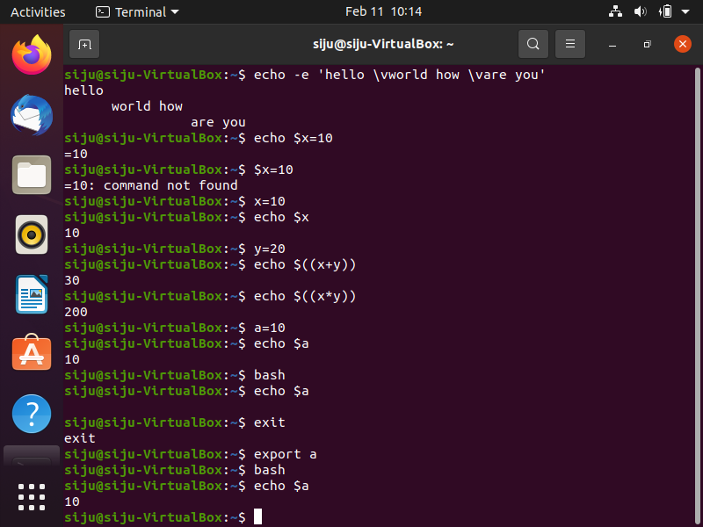

Slide 7
Shell: introduction
Shell checks to see whether the file/etc/profile exists. If it exists the shell reads it otherwise skips it with no error.
‘.profile,’ exists in our home directory.
env command is used to display the environment variables in the shell.
It is similar to set command.

Slide 8
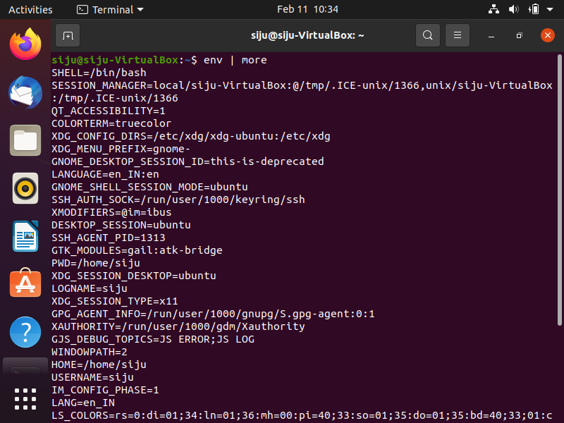
screenshot

Slide 9
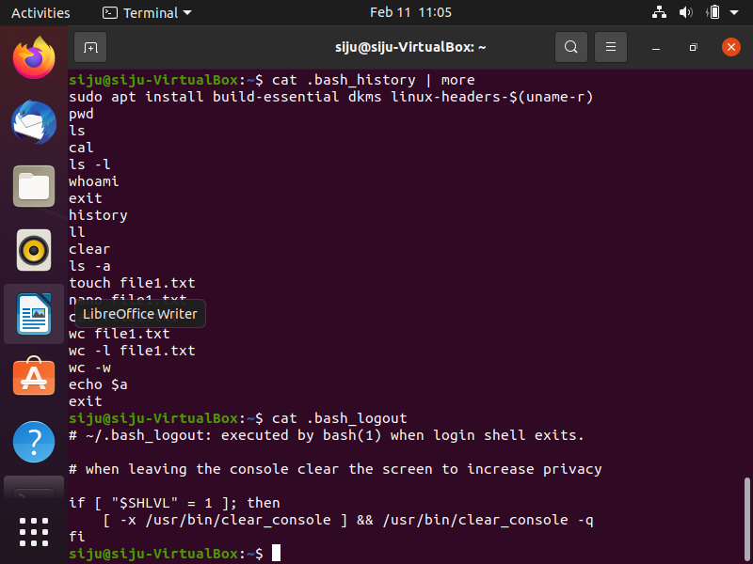
screenshot

Slide 10
Basic utilities in shell scripting
pr command: used to prepare file for printing with suitable header, footers etc.
Eg: pr -2 numbers pg 1
Displayed as: when created nos
1 5
2 6
3
4
Here value 2 is referred to as number of columns.

Slide 11
Pipes, filters and sort
Pipe send output of one operation as input of another operation.
Filter is used to modify it.
Sort is used to sort the files in a particular order.

Slide 12
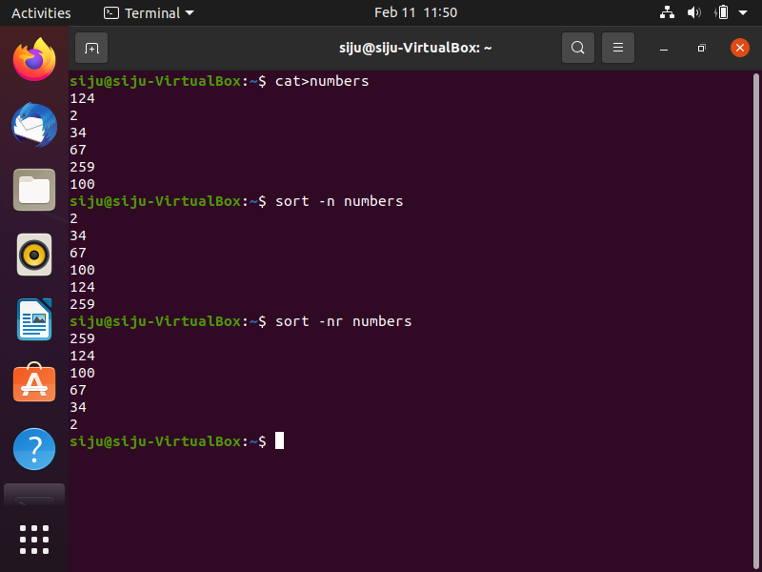
Screenshot

Slide 13
editors
There are different types of editors.
Nano editor: nano <filename.ext>
Gedit editor: It can be used to browse files in the O.S. very easily
Vi/ Vim editor

Slide 14
Vi editor
Vi editor uses command lines for everything
Vim is Vi improved.
To open files by vi editor : vi<filename> or it creates the file if it doesn’t exist.
For read only view : vi –R <filename>
There are 2 modes:
Command mode: everything is interpreted as command here.
Insert mode: enables to insert text into the file.

Slide 15
Contd..
The default mode is command
For insertion, press ‘I’.
To quit and save the changes : ‘:wq’ and not save :’:q!’
For getting out of insert mode use ‘esc’ key.
To copy a single line , use ‘yy’
To paste, use ‘p’
To delete a single line, use ‘dd’

Slide 16
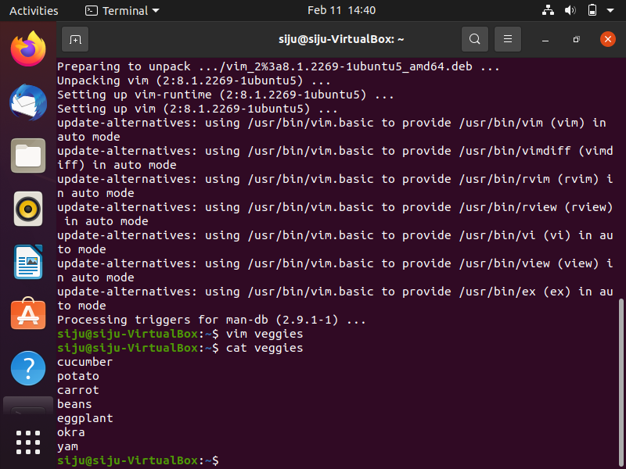
screenshot

Slide 17
Shell scripting :basics
It translates high level programming languages to machine language.
Types of shells:
sh secured shell
ksh korn shell and compatible with bourne shell
csh supports c programs
Bourne again shell(bash) it is a combination of all the above shells

Slide 18
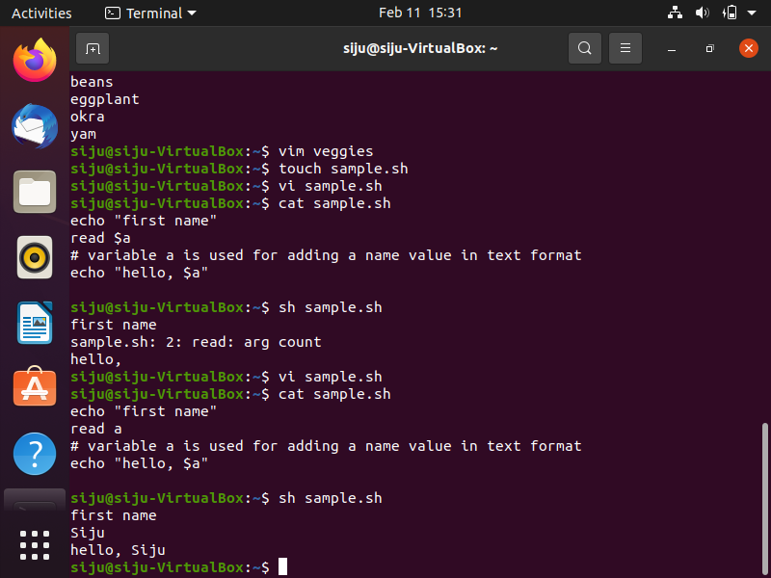
Screenshot of some basic commands in shell

Slide 19
Variables in shell scripting
Local variable
Environment variable
We can assign multiple values to a single variable as it keeps on overwriting it.
So after overwriting the new values are displayed.
To show old values new variables are to be created.

Slide 20
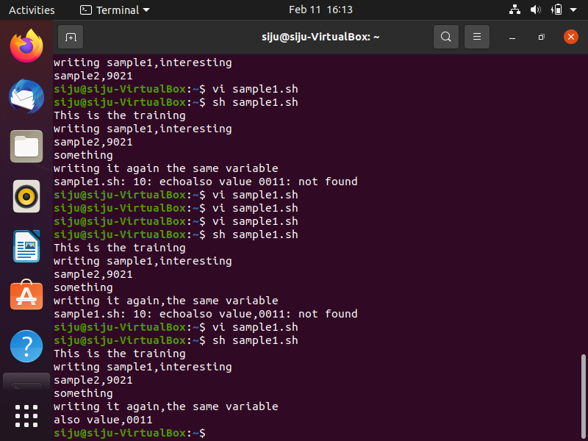
screenshot

Slide 21
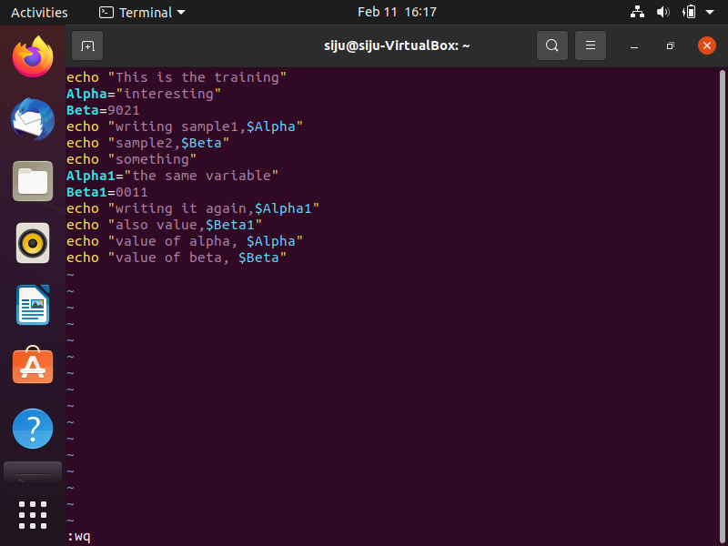
screenshot

Slide 22
Shell arrays
It helps to store similar kind of data under a single variable name.

Slide 23
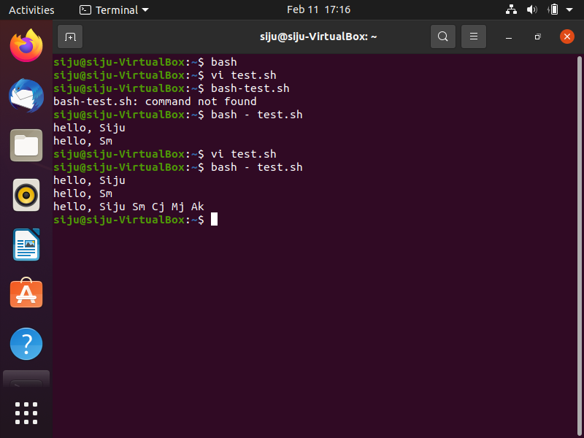
screenshot

Slide 24
Shell operators
Arithmetic operator: helps in calculation
Relational operator: relation between two entities
Boolean operator: contain of only 2 values true and false
String operator: operations between 2 strings
File test operator: used to work on files

Slide 25
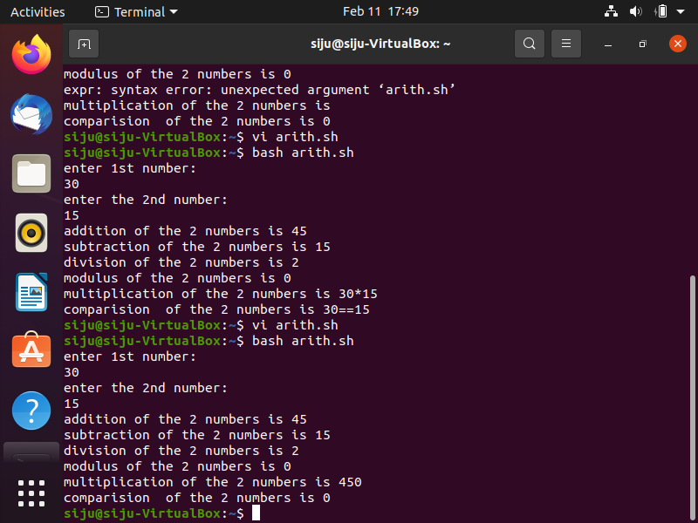
Arithmetic operations screenshot

